Slide 1

CUSTOMER’S PURCHASE BEHAVIOR

Slide 2
Introduction
Objective:
Analyze sales data to uncover key insights into product performance, customer behavior,
and market trends.

Slide 3
Data cleaning
At the first for data cleaning we got a dataset that has some faulty customer and product id’s. So for that I imported the data in Mysql workbench and assign new unique id’s for customers and products that’s the only data cleaning process that is needed in this dataset.
After cleaning the data I seprated the given table in 3 different tables so that it will give a easy view while looking into it like a table for customer information one for product detail and one for purchase information.
After cleaning the data I did some analyze work with the help of Mysql and powerbi, my analysis results can be seen forward.

Slide 4
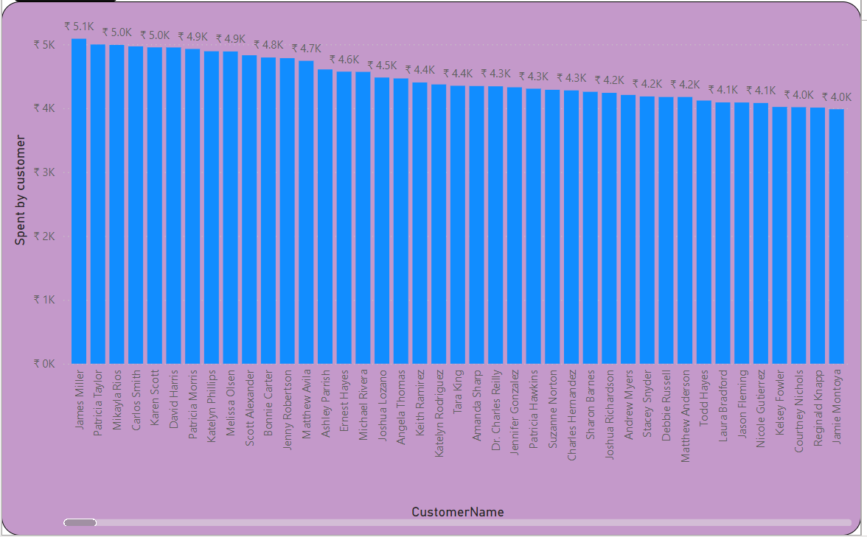
Insight-1
Here are our top customers according to their money spent with us .
These are our valuable customers so we can prioritize them in some conditions.

Slide 5
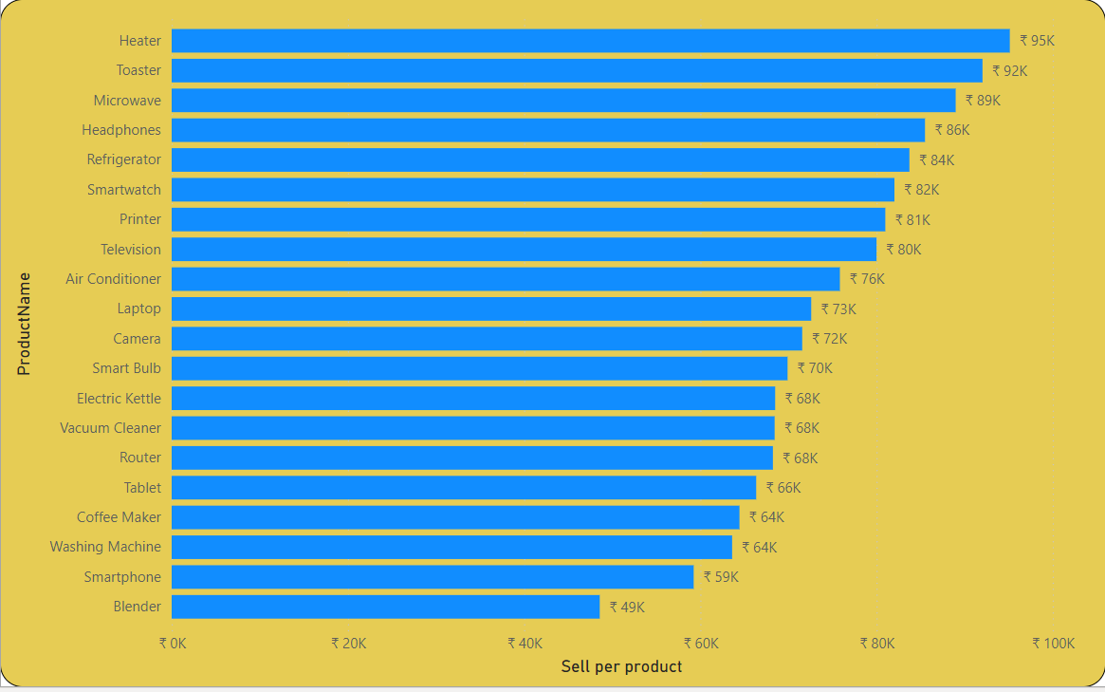
Insight-2
In this chart we can see our top selling products . These are the products that in demand in our business

Slide 6
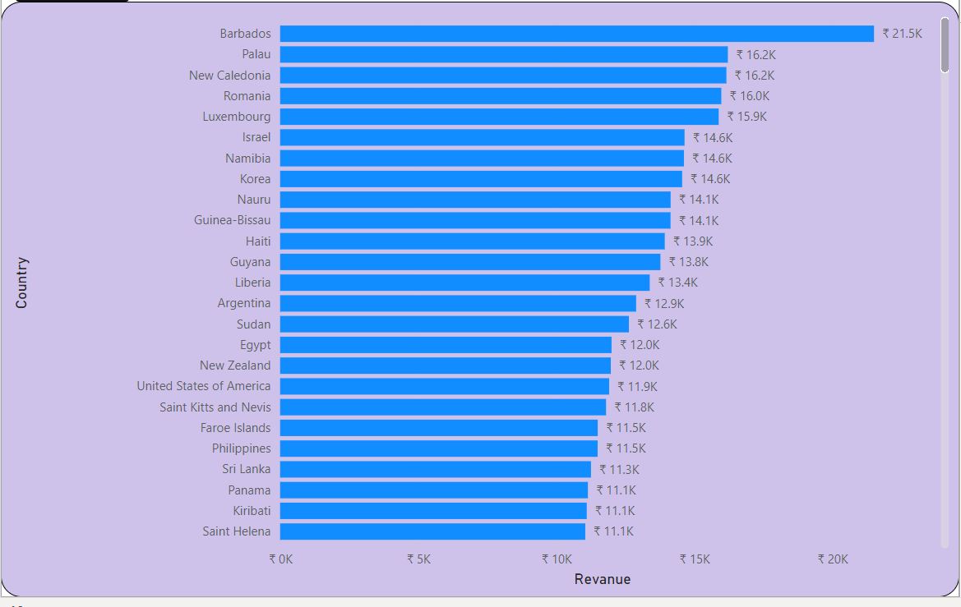
Insight - 3
These are the countries where we are popular the moost .

Slide 7
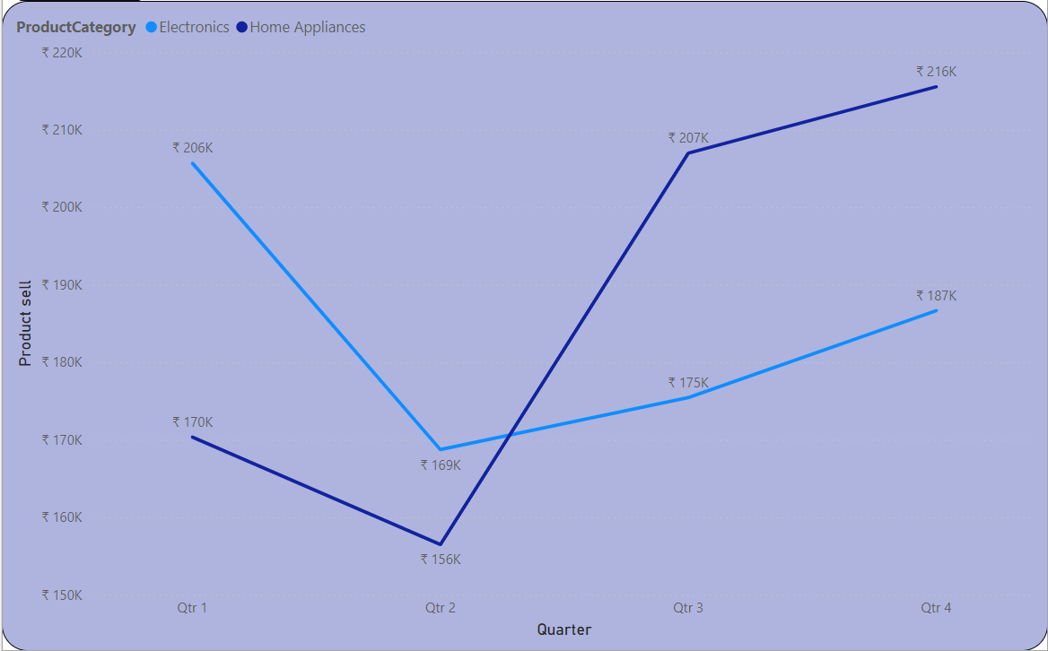
Insight - 4
Here we have quarter wise sale there we can see we don’t have a good 2nd quarter and top sale in the final quarter of year and the distribution is same for both categories.

Slide 8
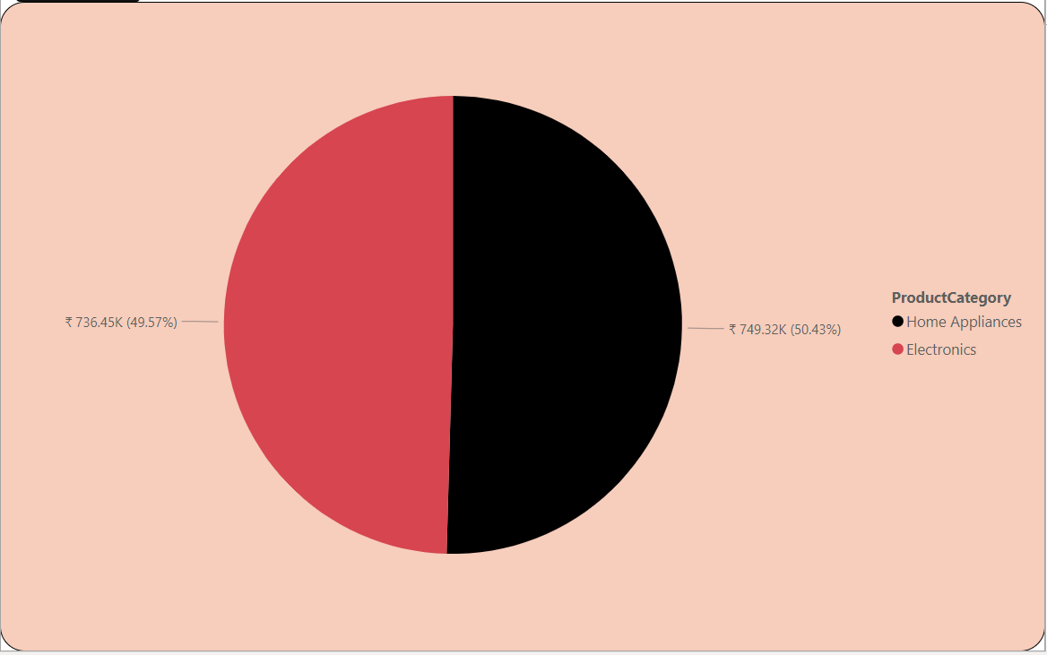
insight - 5
And finally we have our last insight that shows sells by product category . We don’t have any bid diffrence between the categories but home applienceis leads the table a little .

Slide 9

CONCLUSION
Focus on expanding and innovating within high-demand categories.
Implement findings into strategic business plans.
Sales peak during specific months, indicating seasonal influences.
NAME OF PRESENTER – SHAHZAD MALIK

